Slide 1
Convolutional Neural Networks
Reference : Chap 3 CNN
Pro Deep Learning with
TensorFlow by Santanu Pattanayak(電子書)

Slide 2
Convolution
Dirac Function ➔continuous function

Slide 3
Dirac Function ➔Discrete function

Slide 4
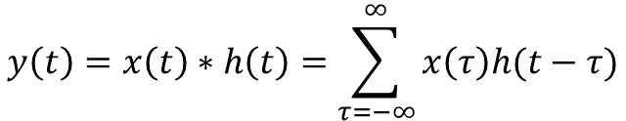
Convolution for Signals in 1-D
For Discrete Case :
$$y\left(t\right)=x\left(t\right)∗h\left(t\right)=\sum_{τ=−∞}^{∞}{x\left(τ\right)h(t−τ)}$$
For Continuous Case :

Slide 5
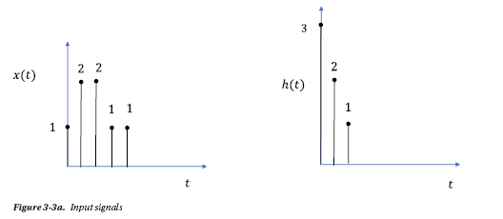
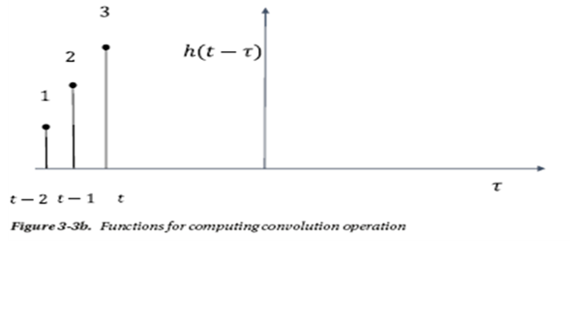
Ex1: Convolution
h(0)=3 ➔ if t=τ then h(t-τ)=3
h(1)=2 ➔if t-τ=1 (τ=t-1)
then h(t-τ)=2
h(2)=1 ➔if t-τ=2 (τ=t-2)
then h(t-τ)=1

Slide 6
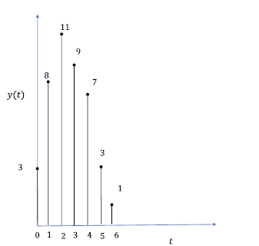
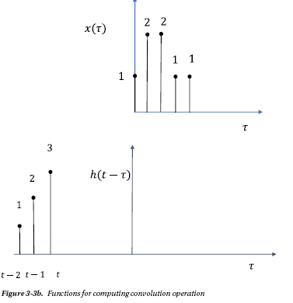
t=0 ➔ y(0)=3x1=3
t=1 ➔ y(1)=3x2+2x1=8
t=2 ➔ y(2)=3x2+2x2+1x1=11
t=3 ➔ y(3)=…

Slide 7
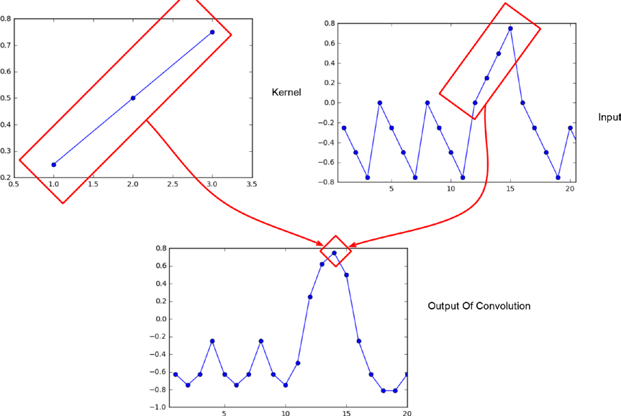
1D convolution

Slide 8
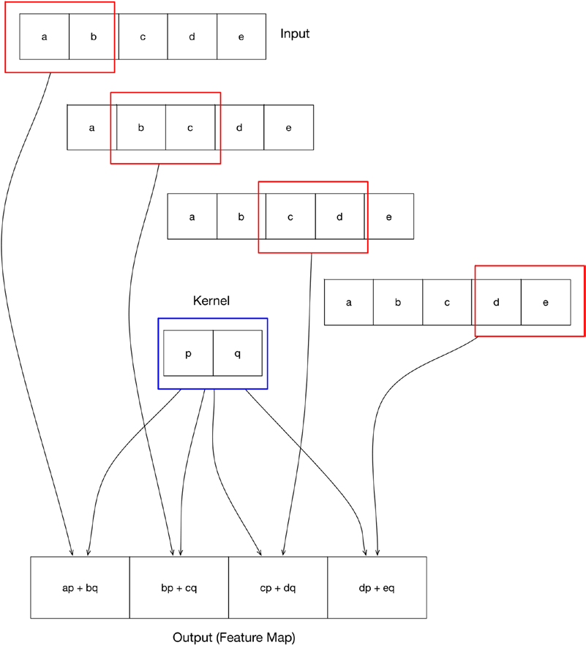

Slide 9

2D and 3D signals
where n1 and n2 are the discrete spatial coordinates along t
he horizontal and vertical axes respectively and
x(n1, n2) denotes the pixel intensity at the spatial coordinates.
coordinate. For an RGB image of dimensions
N xMx3 , the signal can be expressed as
where xR, xG, and xB denote the pixel intensities along the Red, Green, and Blue color channels.

Slide 10


Two-dimensional Unit Step Function
A two-dimensional unit step function δ(n1, n2), where n1 and n2 are the horizontal and vertical coordinates, can be expressed as
A shifted unit step function can be expressed as

Slide 11

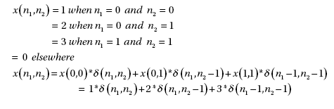
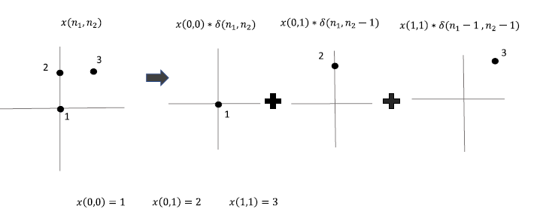
Any discrete 2D signal can be written as follows:
Ex:

Slide 12
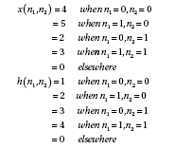
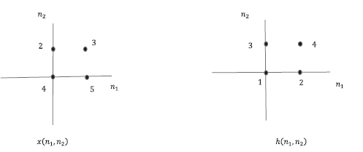
2D Convolution
y(n1,n2)=
Ex: x(n1,n2): signal
h(n1,n2): kernel

Slide 13
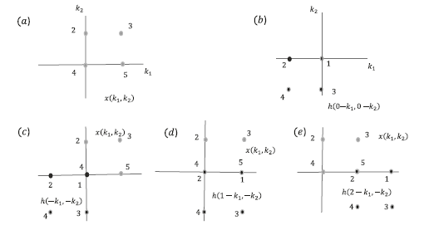

Slide 14
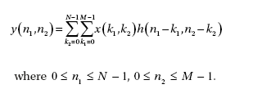
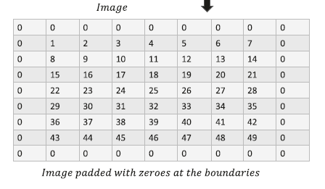
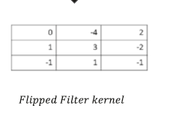
An example of 2D convolution

Slide 15
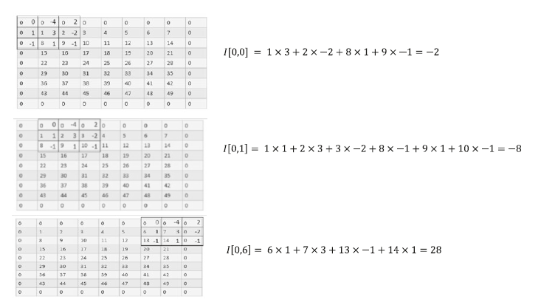

Slide 16
Common Image-Processing Filters
1. Mean Filter :The Mean filter or Average filter is a low-pass filter that computes the local average of the pixel intensities at any specific point.
The kernel :h(n1,n2)

Slide 17
2. Median filter
Median :
2D Median filter replaces each pixel in a neighborhood with the median pixel intensity in that neighborhood based on the filter size.
Median 是找出所有點的中間值

Slide 18
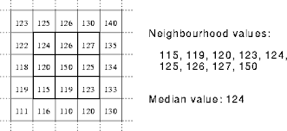
2. Median Filter
Median = 124
Average=(124+126+127+120+150+125+115+119+123)/9=125.4

Slide 19
中值濾波器是一種常用的非線性濾波器，其基本原理是選擇待處理像素的一個鄰域中各像素值的中值來代替待處理的像素
主要功能是像素的灰度值與周圍像素比較接近，從而消除孤立的噪聲點，所以中值濾波器能夠很好的消除椒鹽噪聲。
不僅如此，中值濾波器在消除噪聲的同時，還能有效的保護圖像的邊界信息，不會對圖像造成很大的模糊（相比於均值濾波器）。

Slide 20
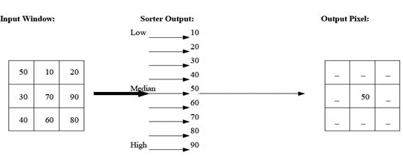
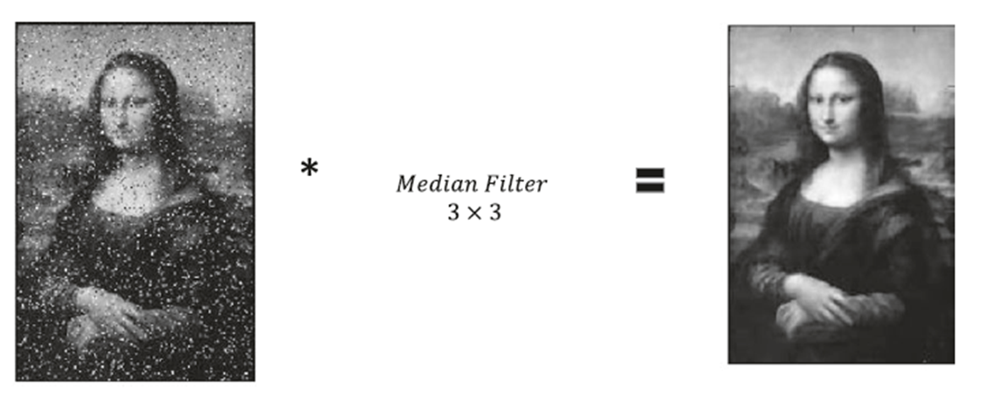
Median Filter

Slide 21
3. Gaussian Filter
The Gaussian filter is a modified version of the Mean filter where the weights of the impulse function are distributed normally around the origin

Slide 22
單純從效果來看, 兩個模板都起到了平滑的作用, 只是程度有深淺的區分.
那麼從理論上來說為什麼能起到平滑的作用呢?
很顯然, 像素的顏色不僅由自身決定了, 同時有其周圍的像素加權決定, 客觀上減小了和周圍像素的差異. 同時這些權重的設定滿足了越近權重越大的規律.
從理論來講, 這些權重的分布滿足了著名的所謂高斯分布:

Slide 23
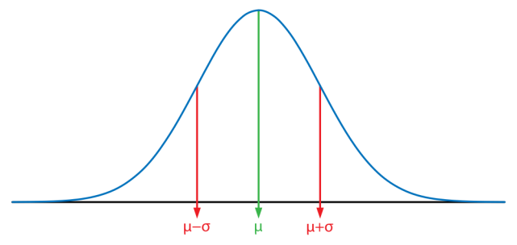

Gaussian Function 1D
1-dim : μ=0
μ= 0 and σ=1

Slide 24

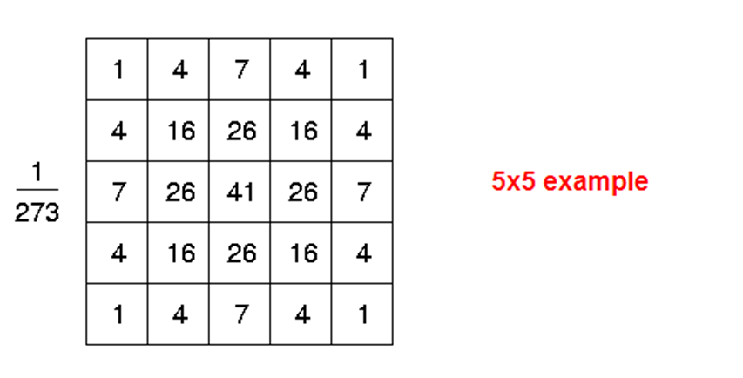
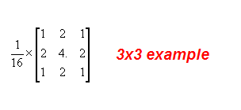
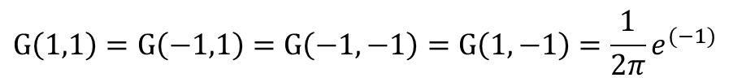
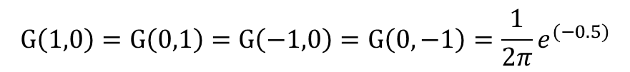

Gaussian Function 2D
μ= (0,0) and σ=1
2-dim:
σ=1
➔
$$G\left(0,0\right)=\frac{1}{2π}$$
$$G\left(1,0\right)=G\left(0,1\right)=G\left(−1,0\right)=G\left(0,−1\right)=\frac{1}{2π}e^{(−0.5)}$$
$$G\left(1,1\right)=G\left(−1,1\right)=G\left(−1,−1\right)=G\left(1,−1\right)=\frac{1}{2π}e^{(−1)}$$

Slide 25
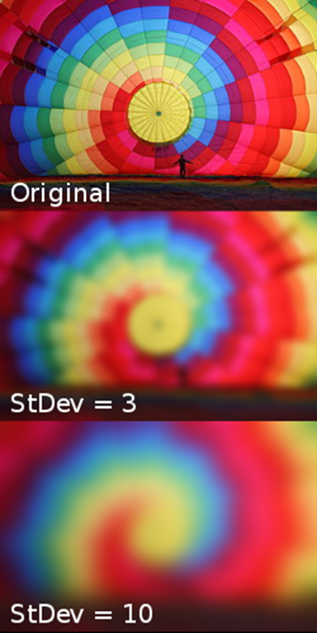
Gaussian

Slide 27
convolve2d
scipy.signal.convolve2d(f,g,shape)
shape = ‘full’: output size is sum of sizes of f and g
shape = ‘same’: output size is same as f
shape = ‘valid’: output size is difference of sizes of f, g

Slide 28
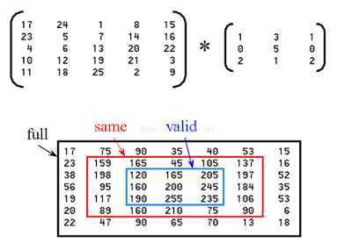

Slide 29
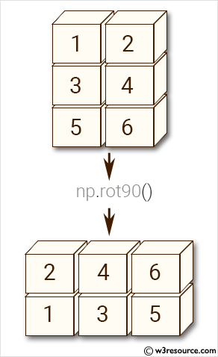
矩陣旋轉90°函數：
np.rot90(m,k=1,axes=(0,1))
m:兩個或多個維度的陣列。
k:矩陣旋轉90度的次數
axes:陣列在由座標軸定義的平面中旋轉。座標軸必須不同。

Slide 30
Example:
x = np.array([[1, 1, 1, 0, 0], [0, 1, 1, 1, 0], [0, 0, 1, 1, 1], [0, 0, 1, 1, 0],
[0, 1, 1, 0, 0]], dtype='float')
w_k = np.array([[1, 0, 1], [0, 1, 0], [1, 0, 1],], dtype='float')
w_k = np.rot90(w_k, 2)
print (x.shape, w_k.shape)
f = signal.convolve2d(x, w_k, 'valid')
print( f)

Slide 31
Example: convolution
import scipy.signal
import numpy as np
# Take a 7x7 image as example
J= np.array([[1, 2, 3, 4, 5, 6, 7],
[8, 9, 10, 11, 12, 13, 14],
[15, 16, 17, 18, 19, 20, 21],
[22, 23, 24, 25, 26, 27, 28],
[29, 30, 31, 32, 33, 34, 35],
[36, 37, 38, 39, 40, 41, 42],
[43, 44, 45, 46, 47, 48, 49]])

Slide 32
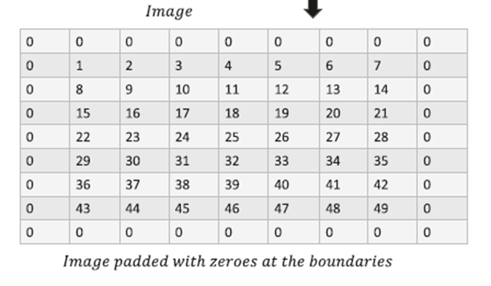

Ex1:
mode=same
[[ -2 -8 -7 -6 -5 -4 28]
[ 5 -3 -4 -5 -6 -7 28]
[ -2 -10 -11 -12 -13 -14 28]
[ -9 -17 -18 -19 -20 -21 28]
[-16 -24 -25 -26 -27 -28 28]
[-23 -31 -32 -33 -34 -35 28]
[-29 13 13 13 13 13 27]]
mode=full
[[ -1 -1 -2 -3 -4 -5 -6 1 -7]
[ -10 -2 -8 -7 -6 -5 -4 28 -7]
[ -29 5 -3 -4 -5 -6 -7 28 -7]
[ -36 -2 -10 -11 -12 -13 -14 28 -7]
[ -43 -9 -17 -18 -19 -20 -21 28 -7]
[ -50 -16 -24 -25 -26 -27 -28 28 -7]
[ -57 -23 -31 -32 -33 -34 -35 28 -7]
[ -14 -29 13 13 13 13 13 27 49]
[ 86 -84 -86 -88 -90 -92 -94 -196 0]]
mode=valid
[[ -3 -4 -5 -6 -7]
[-10 -11 -12 -13 -14]
[-17 -18 -19 -20 -21]
[-24 -25 -26 -27 -28]
[-31 -32 -33 -34 -35]]

Slide 33
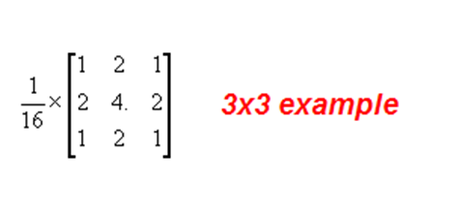
Ex2:kernel filer (3x3)
(a ) Mean Filter (b) Median Filter (C ) Gaussion Filter

Slide 34
tf.nn.conv2d
函數tf.nn.conv2d(input, filter, strides, padding, use_cudnn_on_gpu=None, name=None)有六個參數，其中前面的四個比較主要。
input：輸入圖片，格式為[batch，長，寬，通道數]，長和寬比較好理解，batch就是一批訓練資料有多少張照片，通道數實際上是輸入圖片的三維矩陣的深度，如果是普通灰度照片，通道數就是1，如果是RGB彩色照片，通道數就是3，當然這個通道數完全可以自己設計。
filter：就是卷積核，其格式為[長，寬，輸入通道數，輸出通道數]，其中長和寬指的是本次卷積計算的“抹布”的規格，輸入通道數應當和input的通道數一致，輸出通道數可以隨意指定。
strides:是步長，一般情況下的格式為[1，長上步長，寬上步長，1]，所謂步長就是指 (卷積核）每次在長和寬上滑動多少會停下來計算一次卷積。這個步長不一定要能夠被輸入圖片的長和寬整除。
padding：是卷積核（抹布）在邊緣處的處理方法，描述起來比較複雜，一張圖比較直觀，直接上圖：

